Slide 1

Database System Architecture
Presented By:
Elizer Ponio Jr. Department of Computer Science
College of Computing and Information Technologies

Slide 2
Outline
Centralized Database Systems
Server System Architecture
Parallel Database Systems
Distributed Database Systems

Slide 3
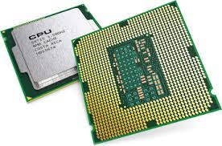

Database System Architecture
The architecture of a database system is greatly influenced by the underlying computer system on which it runs, in particular by such aspects as processor and memory archi- tecture, and networking, as well as by requirements of parallelism and distribution.

Slide 4
Database System Architecture
The earliest databases were built to run on a single physical machine supporting multi- tasking; such centralized database systems are still widely used.
An enterprise-scale application that runs on a centralized database system today may have from tens to thousands of users and database sizes ranging from megabytes to hundreds of gigabytes.

Slide 5
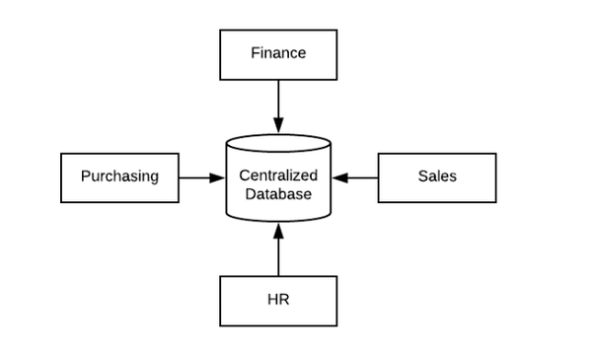
Centralized Database Systems
Centralized database management system is the system in which all the data is stored and managed in a single unit.
This system is mostly used in an organization, in any Business Company or in institution to centralize the tasks.
Data can be accessed through a network Local Area Network (LAN) or Wide Area Network (WAN).
Mainframe computer is the example of centralized database management system.

Slide 6
Centralized Database Systems
Centralized database systems are those that run on a single computer system.
Such database systems span a range from single-user database systems running on:
Mobile devices or personal computers
To high-performance database systems running on a server with multiple CPU cores and disks and a large amount of main memory that can be accessed by any of the CPU cores.

Slide 7


Centralized Database Systems
Single-user systems
Smartphones and personal computers fall into the first category.
A typical single-user system is a system used by a single person, usually with only one processor (usually with multiple cores), and one or two disks.

Slide 8
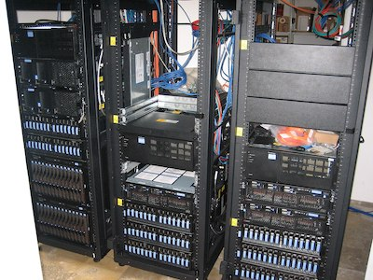
Centralized Database Systems
Multiuser systems
A typical multiuser system has multiple disks, a large amount of memory, and multiple processors.
Such systems serve a large number of users who are connected to the system remotely, and they are called server systems.

Slide 9
Outline
Centralized Database Systems
Server System Architecture
Parallel Database Systems
Distributed Database Systems

Slide 10
Server System Architecture
Server systems can be broadly categorized into two kinds:
Transaction servers
Widely used in relational database systems
Data servers
Parallel data servers used to implement high-performance transaction processing systems

Slide 11
Transaction Server
Transaction servers
Widely used in relational database systems
It provide an interface to which clients can send requests to perform an action, in response they execute the action and send back results to the client.
Transactions
In simple words, a transaction is the exchange of information between two or more entities affecting each other.

Slide 12
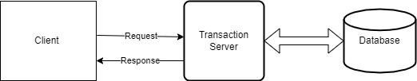
Transaction Server
Requests may be specified by using SQL.
Clients send requests to the server.
Transactions are executed at the server.
Results are shipped back to the client.

Slide 13
How Transaction Server Works?
Suppose, there is a client who wants to access a file from the server, so first of all client makes a connection to the server using TCP protocol, and the translation of the name address into the IP address is done by DNS.
Then they make a request to the server for the particular information or file. This request contains the command, page desired, and the protocol or version.
After this, the server reads the request and sends the requested file to the client and it is called response.
The response contains the status line, header files, and the message body containing the information from the database, and this whole process is called request-response behavior.
It might also happen that server denies some information.
Finally, when the client receives the information, the transaction is terminated.

Slide 14
Data Server
Data-server systems supply raw data to clients.
Data-server systems strive to minimize communication between clients and servers by caching data and locks at the clients. Parallel database systems use similar optimizations.

Slide 15
Outline
Centralized Database Systems
Server System Architecture
Parallel Database Systems
Distributed Database Systems

Slide 16
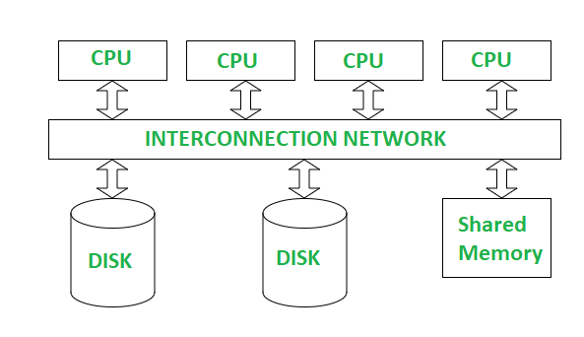
Parallel Systems
Parallel systems improve processing and I/O speeds by using a large number of computers in parallel.
Parallel machines are becoming increasingly common, making the study of parallel database systems correspondingly more important.

Slide 17
Parallel Systems
In parallel processing, many operations are performed simultaneously, as opposed to serial processing, in which the computational steps are performed sequentially.

Slide 18
Parallel Systems
It is not practical to share memory between a large number of processors.
As a result, massively parallel computers are typically built using a large number of computers, each of which has its own memory, and often, its own set of disks.
Each such computer is referred to as a node in the system.

Slide 19
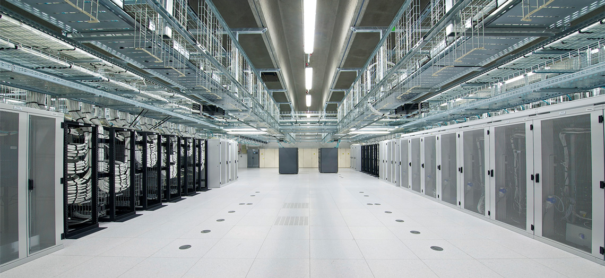
Parallel Systems
Parallel systems at the scale of hundreds to thousands of nodes or more are housed in a data center, which is a facility that houses a large number of servers.
Data centers provide high-speed network connectivity within the data center, as well as to the outside world

Slide 20
Parallel Systems
There are several architectural models for parallel machines.
Shared Memory
All the processors share a common memory
Shared Disk
A set of nodes that share a common set of disks. Each node has its own processor and memory
Shared Nothing
A set of nodes that share neither a common memory nor common disk
Hierarchical
This model is a hybrid of the preceding three architectures

Slide 21
Shared Memory

Slide 22
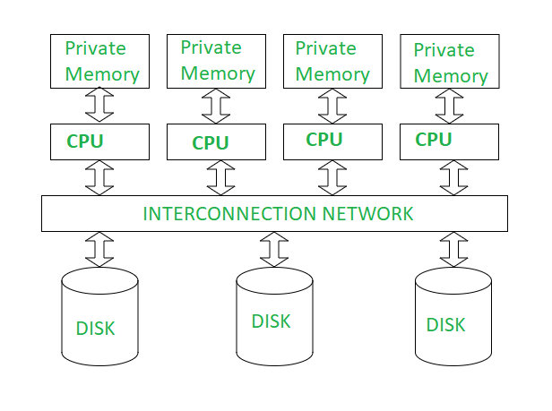
Shared Disk

Slide 23
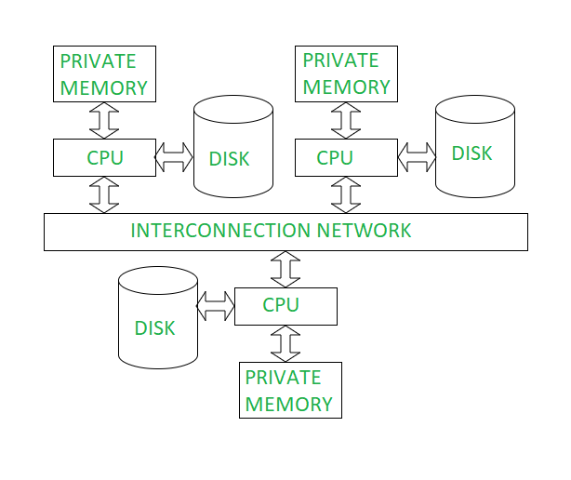
Shared Nothing

Slide 24
Outline
Centralized Database Systems
Server System Architecture
Parallel Database Systems
Distributed Database Systems

Slide 25
Distributed Database System
The database is stored on nodes located at geographically separated sites.
The nodes in a distributed system communicate with one another through various communication media, such as high-speed private networks or the internet.
They do not share main memory or disks.

Slide 26
Distributed vs Parallel
1. Distributed databases have sites that are geographically separated.
As a result, the network connections have lower bandwidth, higher latency, and greater probability of failures, as compared to networks within a single data center.

Slide 27

Distributed Database System
2. Parallel database systems address the problem of node failure.
Failures, particularly those due to earthquakes, fires, or other natural disasters, may affect an entire data center, causing failure of a large number of nodes
Distributed database systems need to continue working even in the event of failure of an entire data center, to ensure high availability.
This requires replication of data across geographically separated data centers, to ensure that a common natural disaster does not affect all the data centers.

Slide 28
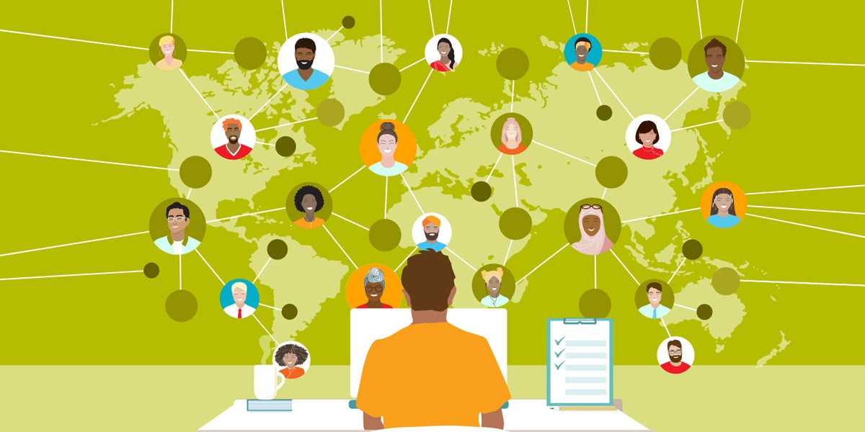
Distributed Database System
3. Distributed databases may be separately administered, with each site retaining some degree of autonomy of operation.

Slide 29
Distributed Database System
4. Nodes in a distributed database tend to vary more in size and function, whereas parallel databases tend to have nodes that are of similar capacity.

Slide 30
Types of Distributed Database System
Homogeneous Distributed Database System
Nodes share a common global schema, all nodes run the same distributed database-management software, and the nodes actively cooperate in processing transactions and queries.
Heterogeneous Distributed Database Systems
In many cases a distributed database has to be constructed by linking together multiple already-existing database systems, each with its own schema and possibly running different database-management software.
The sites may not be aware of one another, and they may provide only limited facilities for cooperation in query and transaction processing.

Slide 31
Benefits of Distributed Database System
Sharing of data
The major advantage in building a distributed database system isthe provision of an environment where users at one site may be able to access the data residing at other sites.
For instance, in a distributed university system, where each campus stores data related to that campus, it is possible for a user in one campus to access data in another campus. Without this capability, the transfer of student records from one campus to another campus would have to rely on some external mechanism.

Slide 32
Benefits of Distributed Database System
Autonomy
The primary advantage of sharing data by means of data distribution is that each site can retain a degree of control over data that are stored locally.
In a centralized system, the database administrator of the central site controls the database.
In a distributed system, there is a global database administrator respon-sible for the entire system.
A part of these responsibilities is delegated to the local database administrator for each site. Depending on the design of the distributed database system, each administrator may have a different degree of local autonomy.

Slide 33
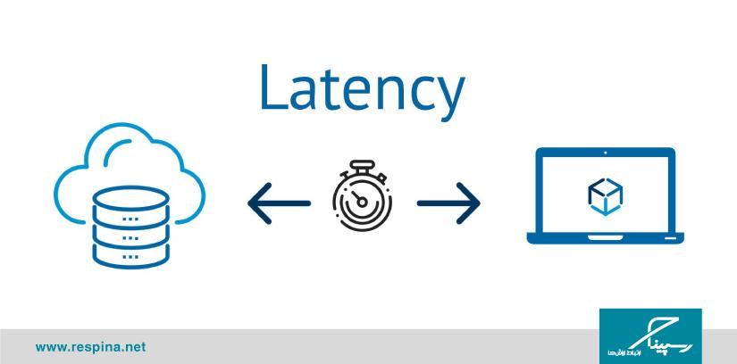
Issues of Distributed Database System
Latency
A message may take up to a few hundred milliseconds to be delivered across the world, both due to speed-of-light delays, and due to queuing delays at a number of routers in the path of the message
Applications whose data and computing resources are distributed geographically have to be carefully designed to ensure that latency does not affect system performance excessively.

Slide 34

Issues of Distributed Database System
Network Failures
Network-link failures may result in two sites that are both alive having no way to communicate with each other, a situation referred to as a network partition
In the event of a partition, it may not be possible for a user or an application to access required data. Thus, network partitioning affects the availability of a system.

Slide 35

Issues of Distributed Database System
Concurrency Control
Since a transaction may access data items at several nodes, transaction managers at several nodes may need to coordinate to implement concurrency control
If locking is used, locking can be performed locally at the nodes containing accessed data items, but there is also a possibility of deadlock involving transactions originating at multiple nodes.
Concurrency means multiple computations are happening at the same time.

